Slide 1
Educational Influences Timeline
Speech Therapy
Undergrad Degree
After School Program Boss
Daycare Experience
Family Friend
Grade 5/6 Teacher
Earth Day Assembly
Highschool Volleyball Coach
Keenen Degen
EDEF 3100-01
Oct 02, 2021

Slide 2
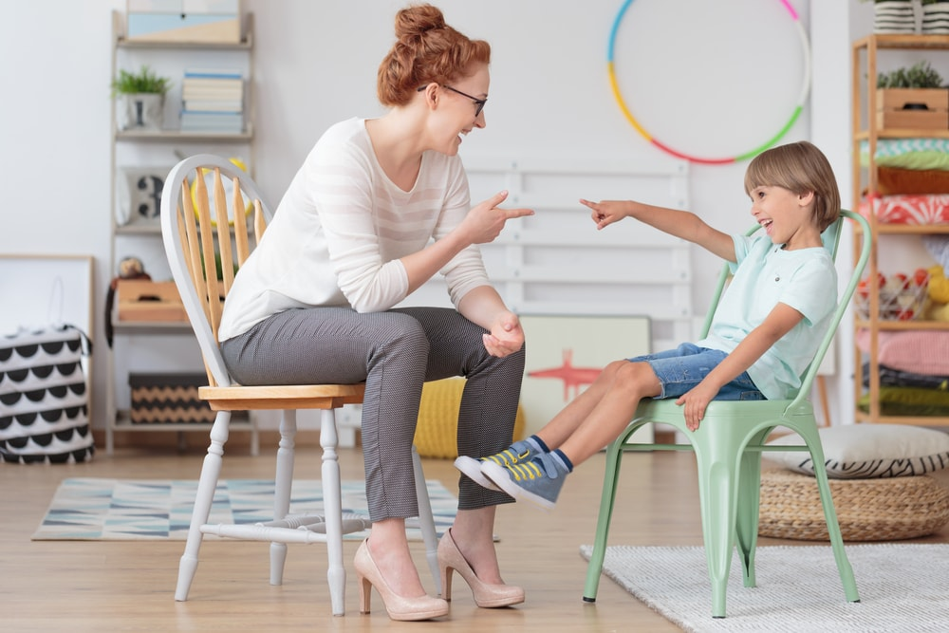
2003- Speech Therapy
In preschool and at the beginning of elementary school nobody could understand me because I had a speech impediment. My mom said I used to get so frustrated because I felt like I made perfect sense but nobody else knew what I was talking about. When I entered kindergarten the school put me into weekly sessions with a speech therapist, and this later transferred into special weekly reading and writing classes. Both of these sessions were spent with specialized teachers that were consistently excited to see my progress. Looking back on this, I think it has played a role in my journey to become a teacher because they were able to make me feel like my challenges were okay and nothing to be embarrassed by. This allowed me to keep my confidence and continue to enjoy school. I also can now reflect on this journey and I think how amazing it would be if I could provide the same type of support, comfort, and teaching to another student in need.
Speech therapy for school-age children. (2020, February 06). Retrieved from https://cliniquego.com/en/speech-therapy-for-school-age-children/

Slide 3
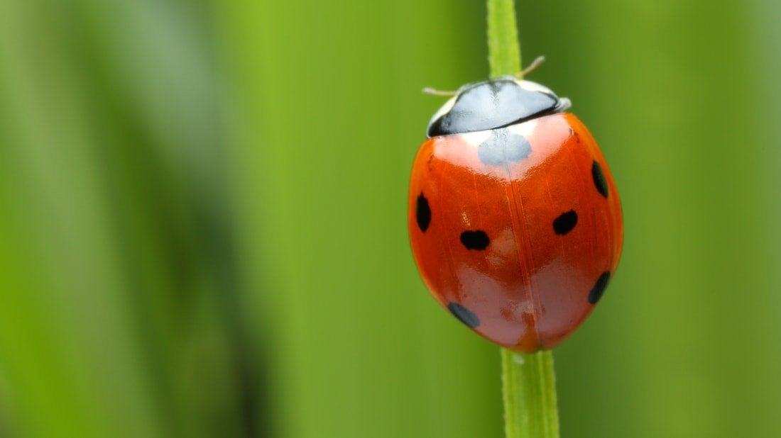
2005- Family Friend
My parents’ friend growing up started my love for learning. She is an environmental scientist that focuses on the mosquito population in Kamloops. I thought this was beyond cool. Growing up I would collect bugs for hours on end. She would always encourage me and even bought me my first bug aquarium. As I got slightly older she would take me out in the field with her to collect samples from ponds. Maybe this did not ignite my desire to be a teacher but I think it was influential because it ignited a desire to learn, to be in nature, and to love science. The fact that I still reflect on these trips and on her positivity and passion shows how much it meant to me in the moment.
Speech therapy for school-age children. (2020, February 06). Retrieved from https://cliniquego.com/en/speech-therapy-for-school-age-children/

Slide 4
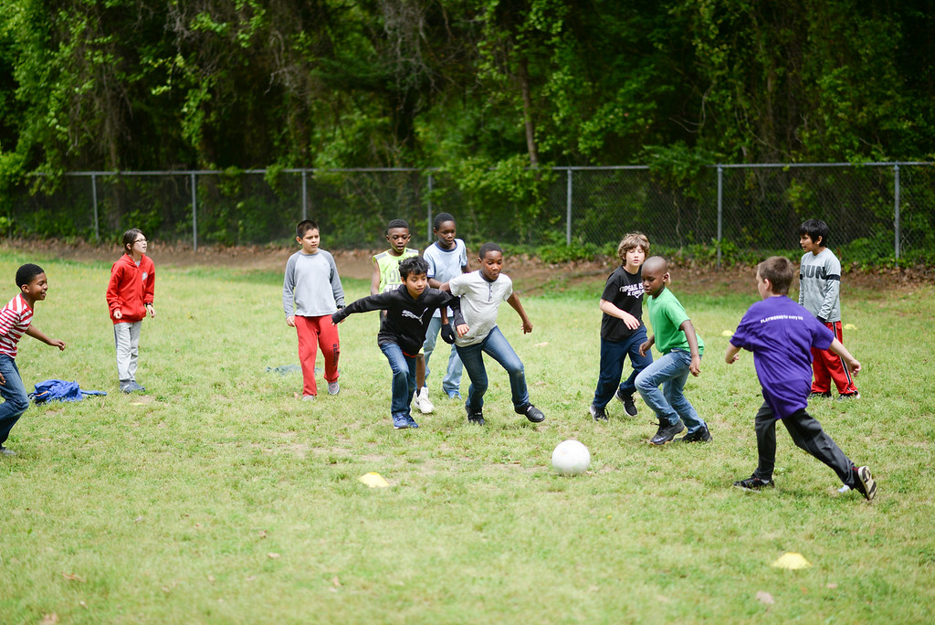
2008- Grade 5/6 Teacher
I had an amazing grade 5/6 teacher. He was a new teacher, I think we might have even been his first class. The thing he was best at was just having fun with us. He would spend lunches out playing soccer with us and made constant jokes (mostly about the show The Office). This is the type of teacher I want to be. I want to be able to take time out of the day to just have fun and to connect with my students. A lot of students need this responsible and trustworthy adult in their life and I think I can fill this role. He also seemed to truly enjoy his job, and I think that’s everyone’s ultimate goal.
How One Tennessee School Turned Recess Around. (2018, March 31). Retrieved from https://www.playworks.org/case-study/one-tennessee-school-turned-recess-around/

Slide 5
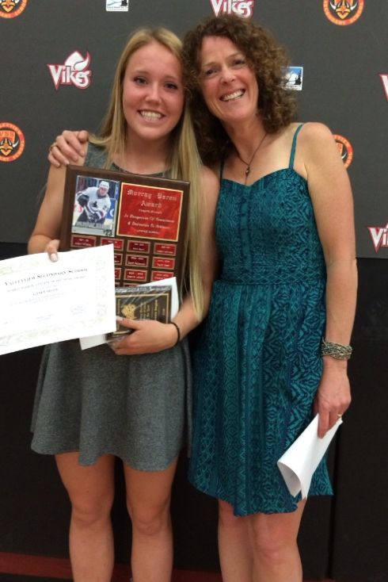
2012 → 2016-Volleyball Coach
My first real thought of becoming a teacher occurred in high school. I played basketball, soccer, and volleyball and had some amazing teacher-coaches. I made connections with all of them. I had one especially good teacher who coached me from grade 8 until grade 12. She not only had knowledge about the sport but she was always there to support us. She presented me with all the athletic awards that I won and when I graduated she was at our graduation. She was a happy face whenever I saw her and I trusted her. Having a teacher like her made me wonder if I could be the same type of support system someday. It made me see that the hard work that she puts in is appreciated and I could do the same thing.

Slide 6
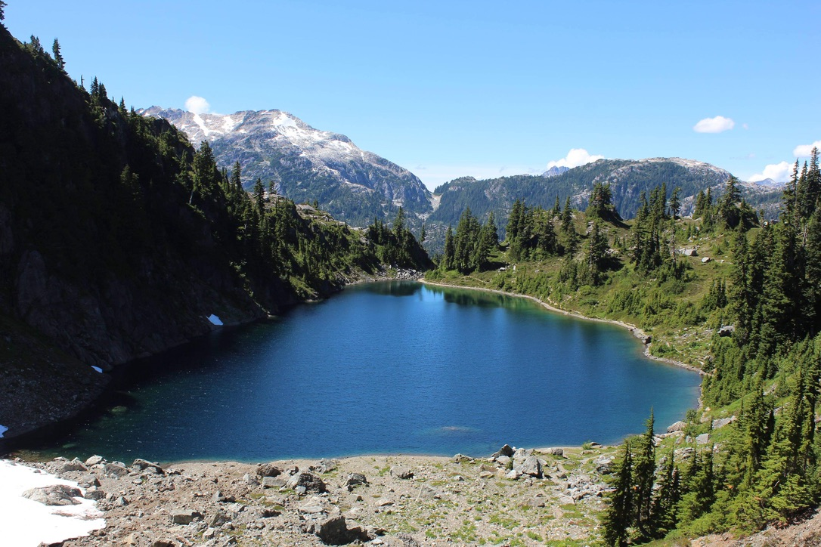
2016-Earth Day Assembly
I am very passionate about the climate crisis and what we can do to prevent global warming. This fear of what might happen stemmed from how much I love nature. I can’t stand to picture a life where we cannot just decide to explore a nearby forest for hours on end. In high school, I found it hard to understand why my fellow classmates couldn’t even bother to recycle their juice box containers. In grade twelve, some fellow classmates and I organized an earth day assembly for the entire school. We talked about how we can cause change and why we need to. Although I know I cannot overwhelm my students with my own opinion on the matter, I think the only way we will see real change is with children’s love for nature. Therefore, if I am able to teach and inspire young students to love nature I truly believe I will be able to make a small but important difference in this world.

Slide 7
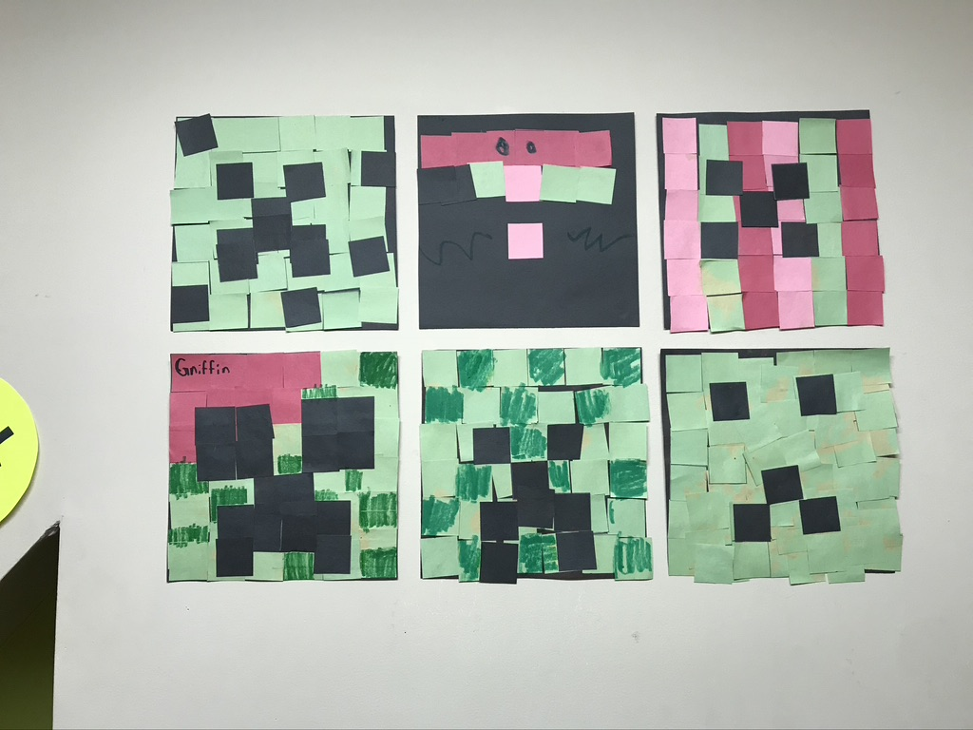
2018-Daycare Experience
During my undergrad, I worked at a daycare. I worked in a room with the 5-7-year-olds. This experience allowed me to see if being a teacher is something that might work for me. One specific circumstance that showed me how rewarding working with children can be was with a girl that found it extremely difficult to control her emotions. She had a hard home life and when she got frustrated she got very frustrated. We would often have to remove her from the rest of the group and work through strategies to calm her back down. I was surprisingly good at this. She would often only want to talk to me and she would let me in on how she was feeling and why she was feeling that way. Although at times it was challenging I loved that she trusted me. It gave me the confidence that I needed to think maybe I could excel at this job and make students’ life just a little bit better.

Slide 8
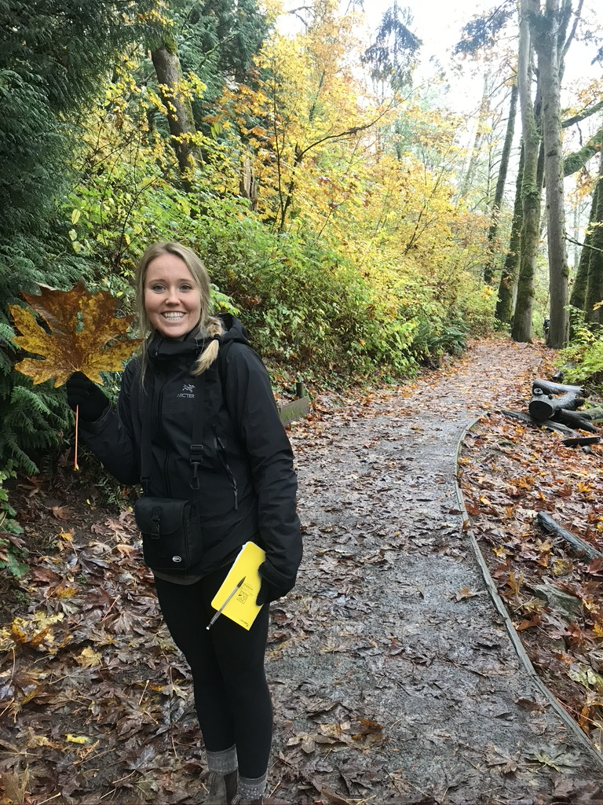
2016→2020-Science Undergrad
As I was studying for my science degree I was still not positive as to where/how I was going to use it. Throughout the degree, I fell more in love with science but I knew that I didn’t want to be writing and reading scientific papers my entire life. The best part of science for me is learning to understand confusing topics and trying to master individual components. This is especially true when it involves going outside studying nature around us. Therefore, when I really thought about how I could combine my love for science, love for learning, and love for children into one career teaching seemed like a great option. I thought about teaching high school but I think reaching children at younger ages and trying to share my passion for science with them can be even more valuable.

Slide 9
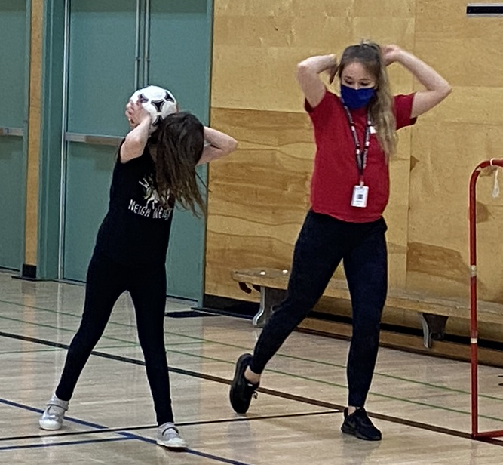
2020-After School Program Boss
I have been lucky enough to work for after-school programs in SD73 for the past three years. When I got hired my boss immediately started me in the position of running programs. I was extremely nervous on the first day. My first 8-week program was a little rocky. I found it difficult to inspire the students to learn about soccer. I asked my boss for some support and she showed up at the next program. We corrected a few things, disciplined a few behaviors, and the program went so much better after that. Now, whenever she visits she has nothing but positive feedback to give me. This was definitely one of the most crucial moments because she let me learn. During this time I was having doubts that I could handle the responsibility of becoming a teacher, but instead of taking over, she helped me become better. She came and supported but she never doubted me.

